Slide 1




MongoDB Design Philosophy
Combining the critical capabilities of relational databases with the innovations of NoSQL technologies
RELATIONAL
NoSQL
MongoDB Architecture Guide
https://www.google.com/imghp

Slide 2
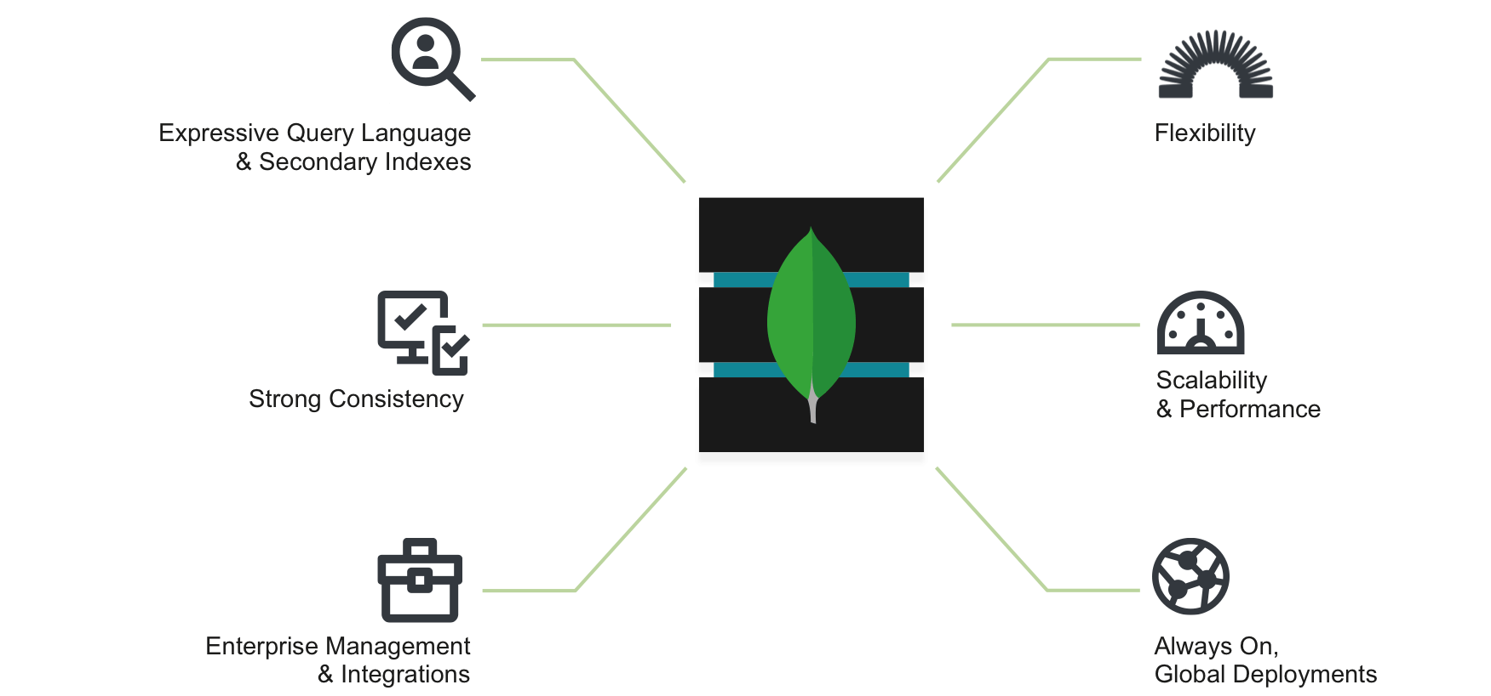
Mongo DB !
https://www.mongodb.com/mongodb-architecture

Slide 3
Traditional DB – Relational DB
Expressive query language - Users should be able to access and manipulate their data in sophisticated ways
Strong consistency - Applications should be able to immediately read what has been written to the database
Enterprise Management and Integrations - A database that can be secured, monitored, automated, and integrated with their existing technology infrastructure
MongoDB Architecture Guide

Slide 4
Modern DB – NoSQL DB
Flexible Data Model - Easy to store and combine data of any structure
Scalability and Performance - Enable almost unlimited growth with higher throughput and lower latency than relational databases.
Always-On Global Deployments – Available systems across many nodes
MongoDB Architecture Guide

Slide 5
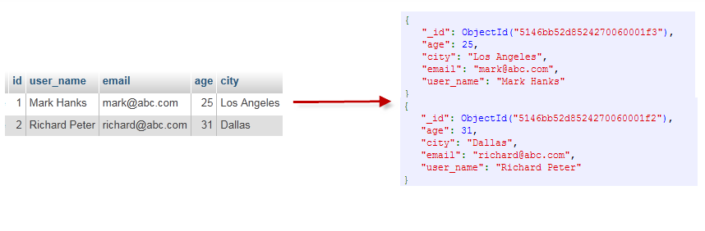
MongoDB Data Model
Data As Documents
MongoDB stores data as documents in a binary representation called BSON (Binary JSON)
BSON extends the popular JSON (JavaScript Object Notation) representation to include additional types such as int, long, date, and floating point
Documents that tend to share a similar structure are organized as collections
MongoDB Architecture Guide
https://cdn.tutsplus.com/net/uploads/2013/11/Figure-1-Mapping-Table-to-Collection-1.png

Slide 6
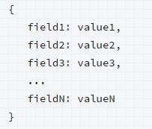
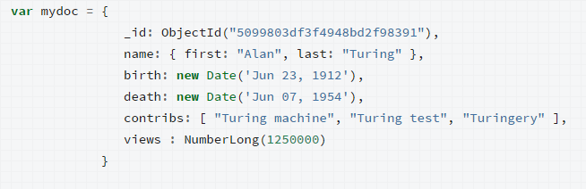
MongoDB Data Model
MongoDB documents are composed of field-and-value pairs and have the following structure:
https://docs.mongodb.org/manual/core/databases-and-collections/#collections

Slide 7
MongoDB Data Model
Dynamic Schema
Fields can vary from document to document
There is no need to declare the structure of documents to the system –documents are self describing
Document Validation
Users can enforce checks on document structure, data types, data ranges and the presence of mandatory fields
MongoDB Architecture Guide

